Slide 1


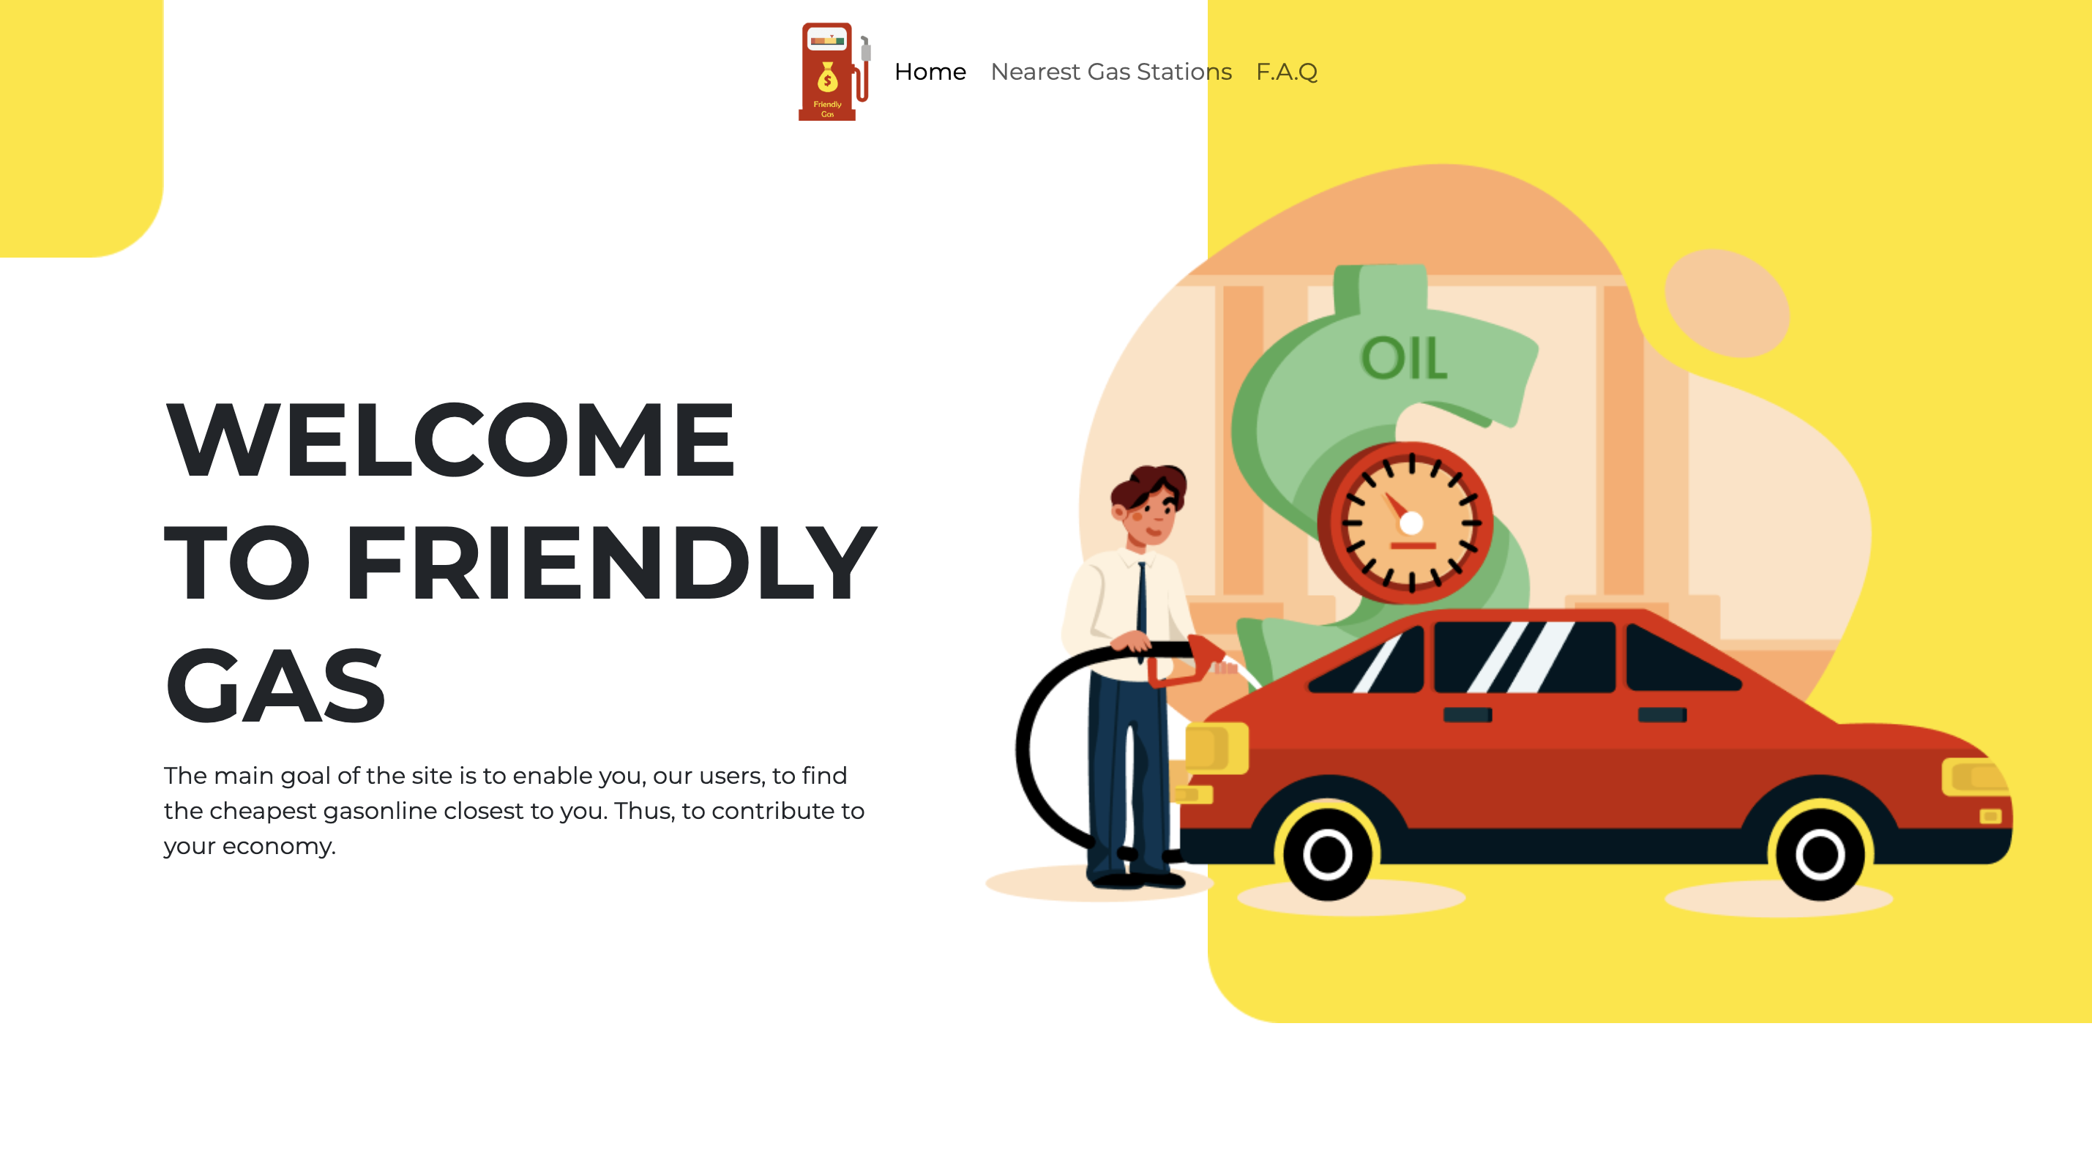
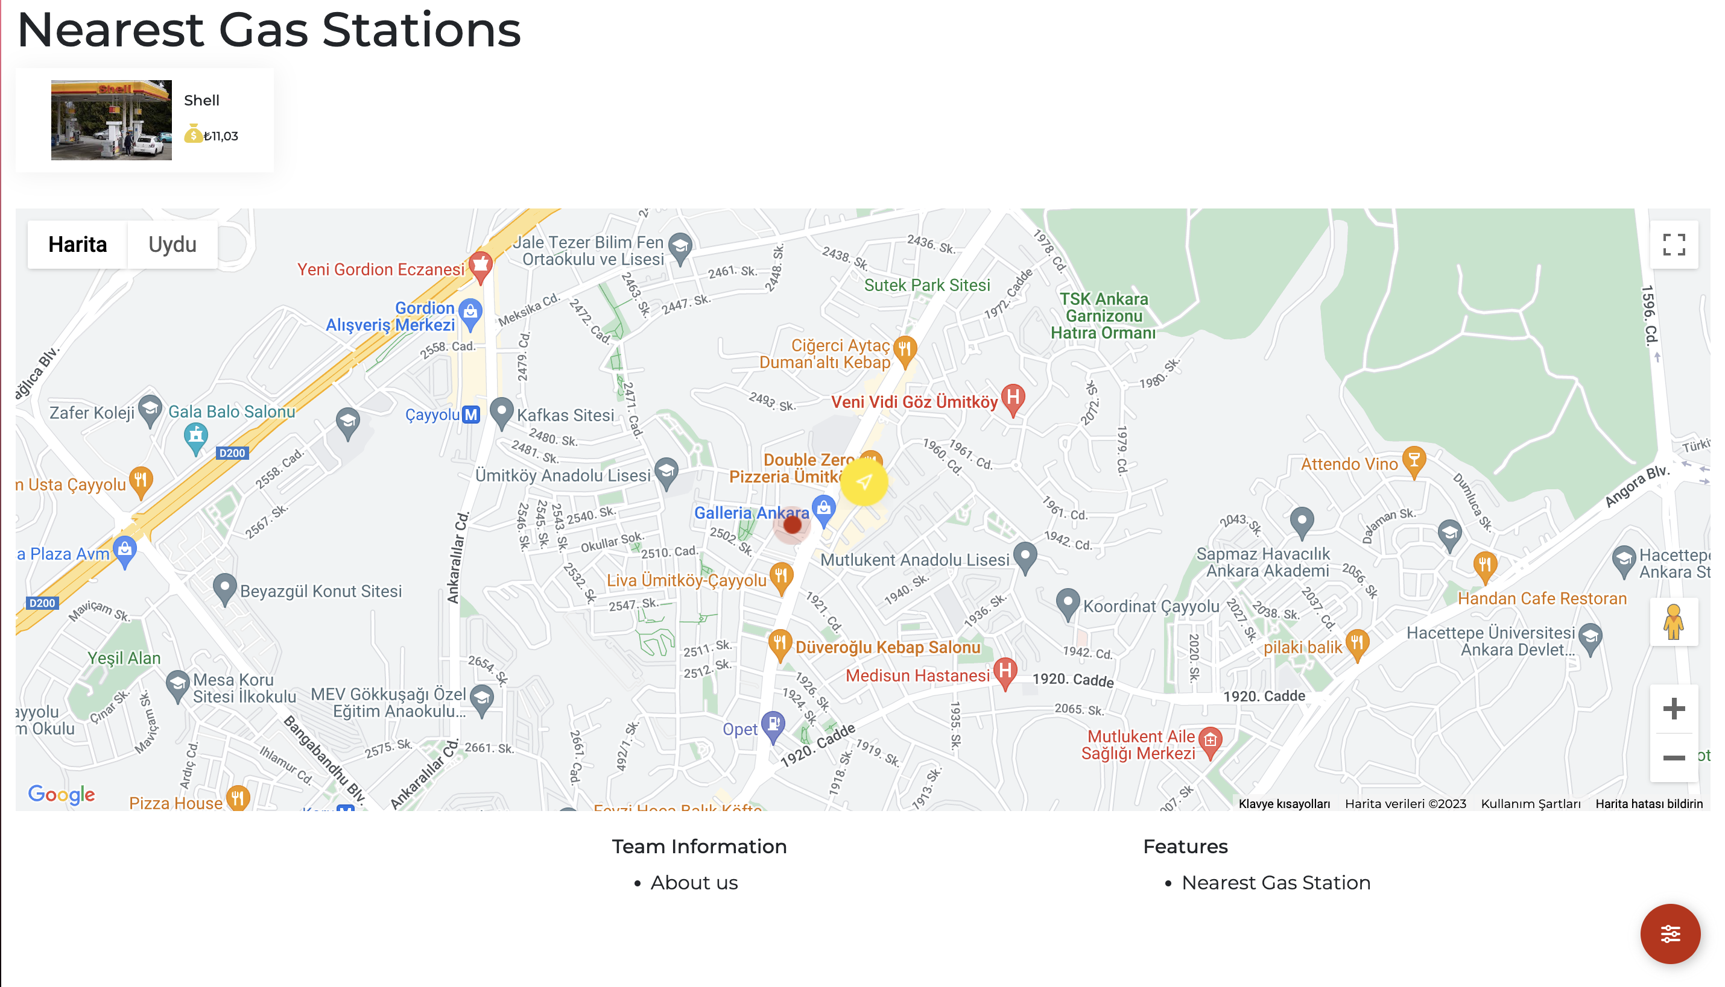
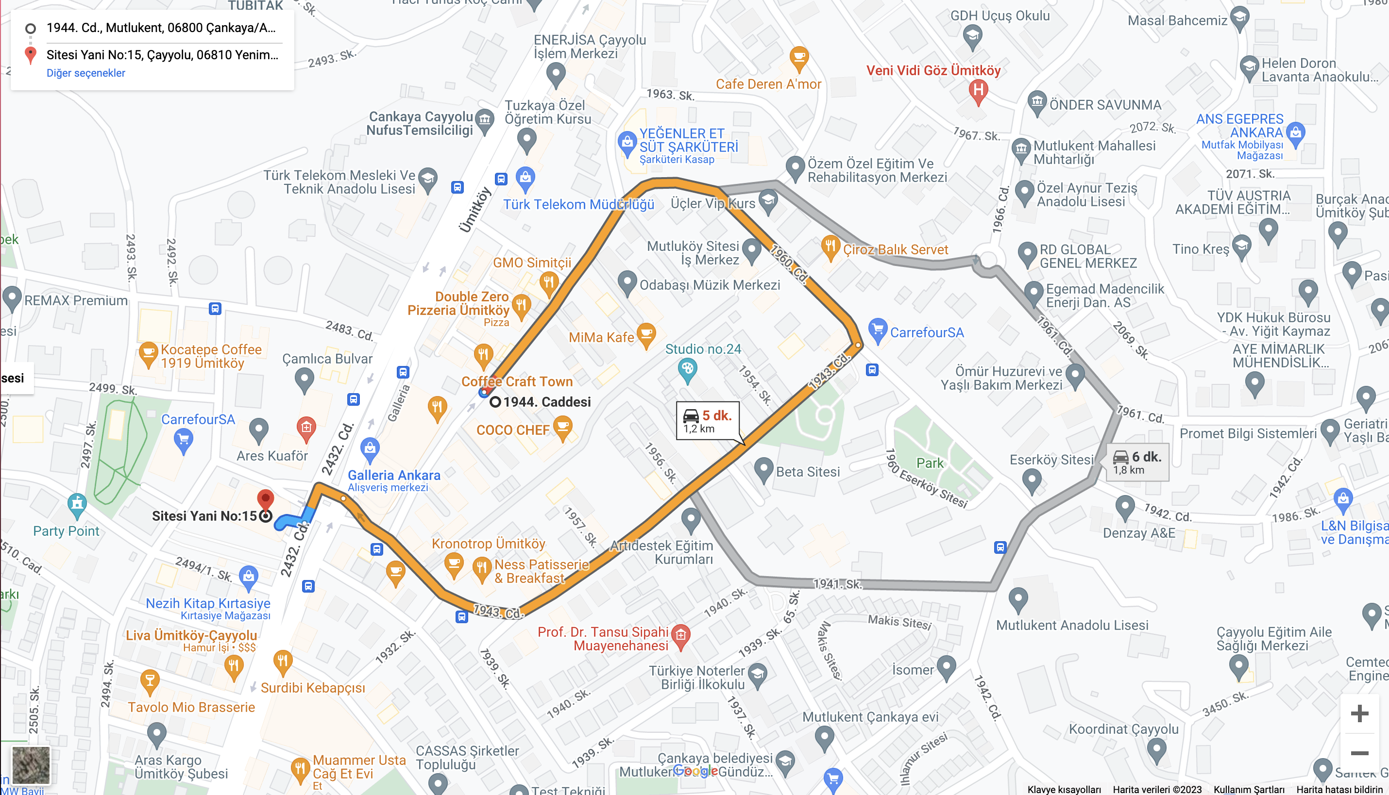
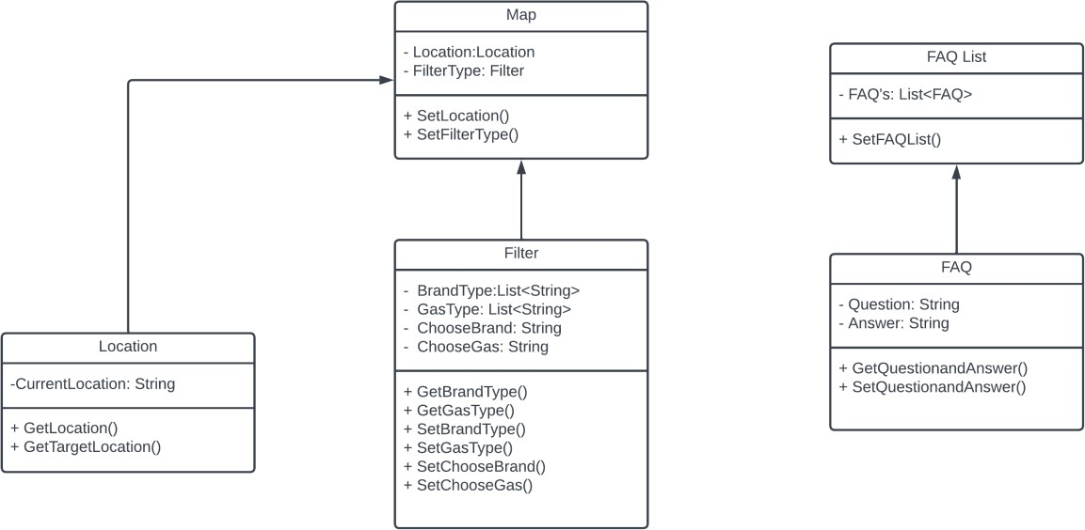
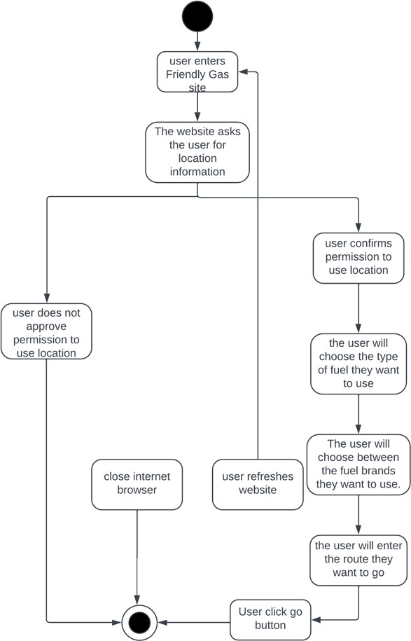
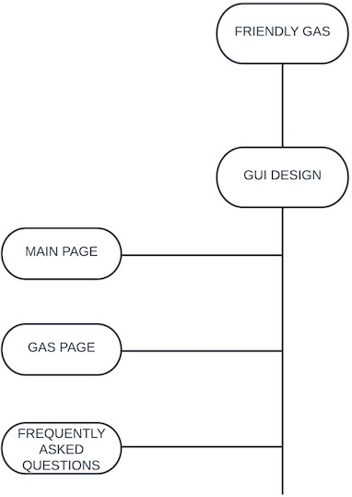
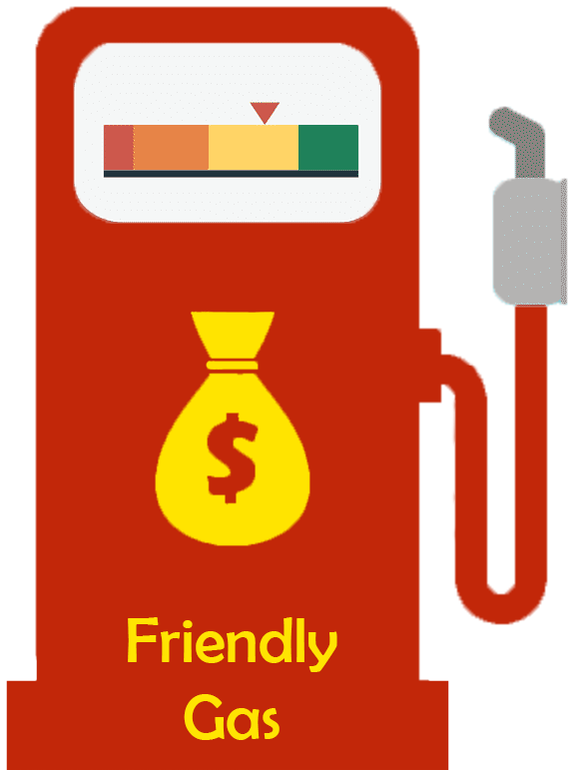
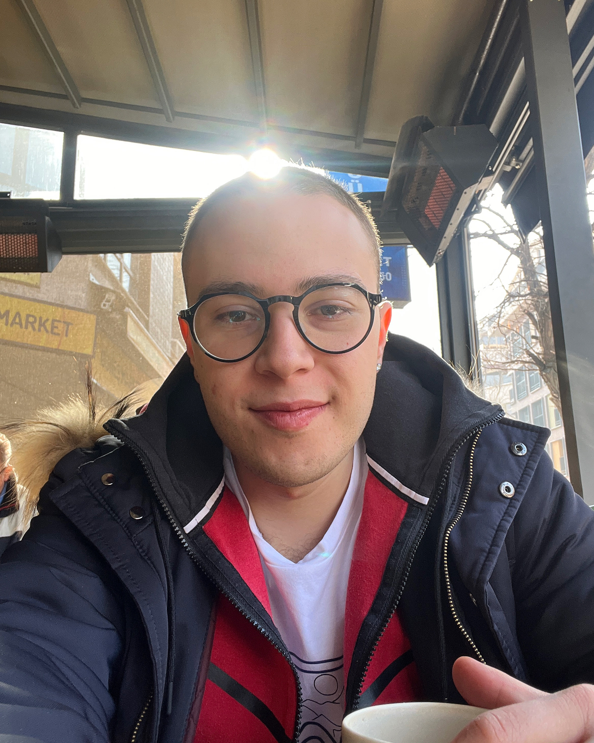
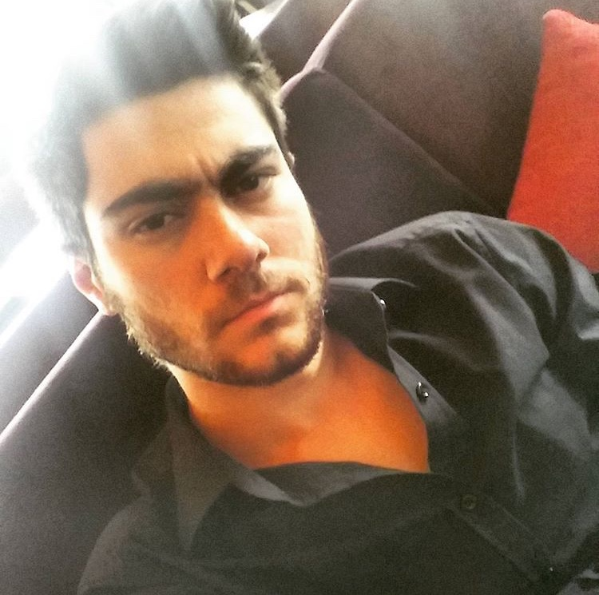
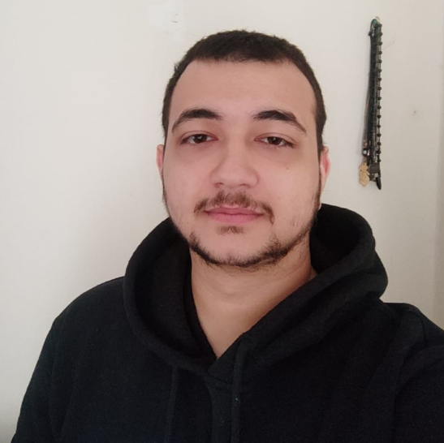
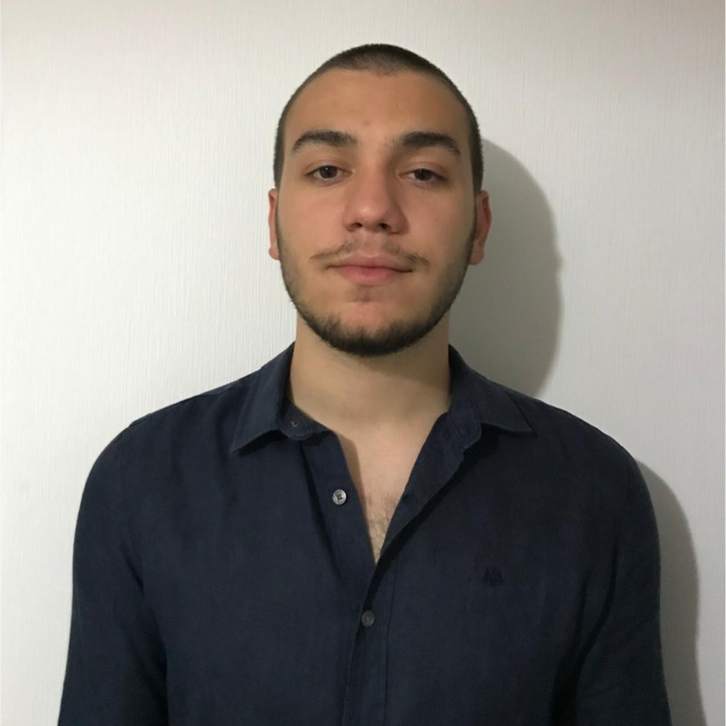
FRIENDLY GAS
Atakan GÖKNAR, Sertan Umut GÜREL, Atakan Taner GÜL, Tonguç Berat ÖZEL
Proje Danışmanları: Faris Serdar TAŞEL
Çankaya University, Department of Computer Engineering
Introduction
This section is to introduce the main subject of the project.Firstly all details about the application will be given details in here after the things we use in this project which we learn in the studies we learned and projects which we did and finally we will give information about similar apps or websites which we have found while we are searching for the project.In todays Turkey gas prices are a valid problem for every person living in our country and we think for a solution about that unfortunately not an exact solution.Our website will be creating most cheap and effective road for the places you will go but in todays world it will be shown the most expensive and different quality gas prices between every gas station and brand.
Finish Product
KONU BAŞLIKLARI:
GİRİŞ
PROJE TANITIMI
Problem
Abstract
In today's world everything is digital what we eat what we buy what we want people do everything on digital platforms and our grup while we were looking for the projects for our 407 and 408 classes we just think why isn’t there anything about gas prices or for the saving about the road you choose with the most efficient and most cheapest way. After we think that we started to researching about applications or websites that includes these types of features. After our researching stage we didn’t found anything special about these features and we decided to go with the website which we will create and includes these features in our project.
Result
Class Diagram
Activity Diagram
Description of Figure
Atakan Göknar
Sertan Umut Gürel
Atakan Taner Gül
Tonguç Berat Özel

